Slide 1

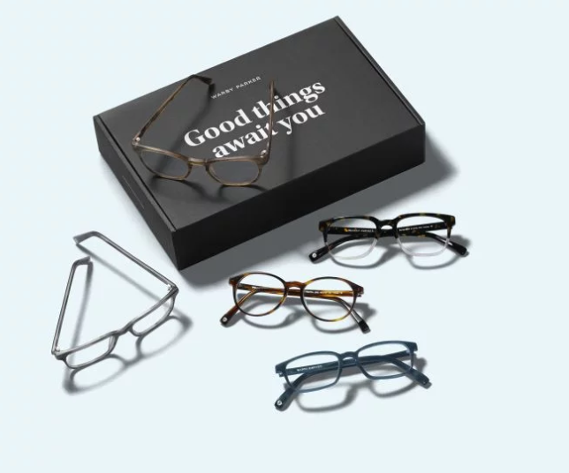
Funnels with Warby Parker
Learn SQL from Scratch
Maria Estrada
11/07/2018

Slide 2
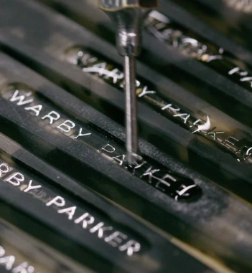
Table of Contents
Get Familiar with Warby Parker
Introduction to Capstone Project
Quiz Funnel Analysis
A/B Testing with with Home Try-On Funnel

Slide 3

Getting Familiar with Warby Parker
Warby Parker is a company that helps people choose their glasses by making it easy for them to try them and offering low cost glasses.
For every pair of eye glasses and sunglasses sold, a pair is given to someone in need.
Warby Parker uses a quiz to help people find the perfect pair of glasses
Check out the website at https://www.warbyparker.com

Slide 4
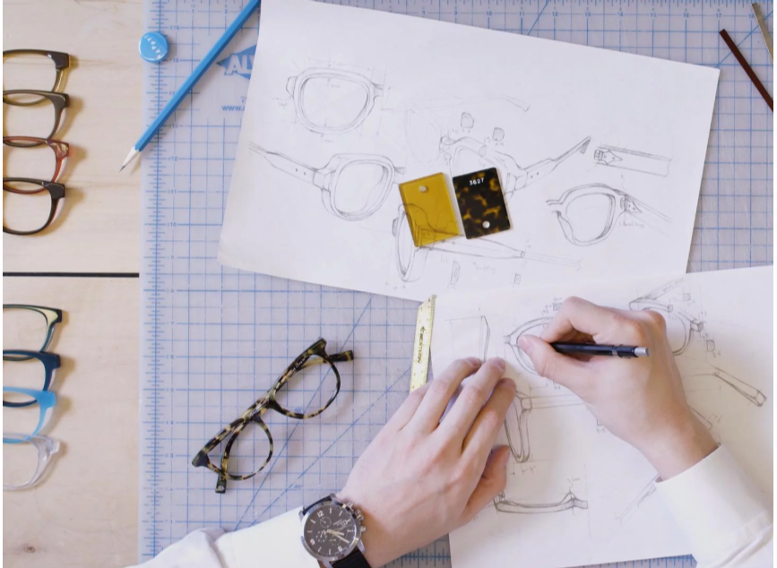
Introduction to the Capstone

Slide 5
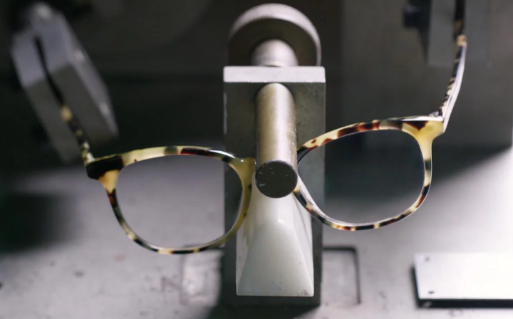
Quiz Funnel:
SELECT *
FROM quiz
LIMIT 10;
The following columns are found in the survey table:
Question
User_id
Response
question | user_id | response
1. What are you looking for? | 005e7f99-d48c-4fce-b605-10506c85aaf7 | Women's Styles
2. What's your fit? | 005e7f99-d48c-4fce-b605-10506c85aaf7 | Medium
3. Which shapes do you like? | 00a556ed-f13e-4c67-8704-27e3573684cd | Round
4. Which colors do you like? | 00a556ed-f13e-4c67-8704-27e3573684cd | Two-Tone
1. What are you looking for? | 00a556ed-f13e-4c67-8704-27e3573684cd | I'm not sure. Let's skip it.
2. What's your fit? | 00a556ed-f13e-4c67-8704-27e3573684cd | Narrow
5. When was your last eye exam? | 00a556ed-f13e-4c67-8704-27e3573684cd | <1 Year
3. Which shapes do you like? | 00bf9d63-0999-43a3-9e5b-9c372e6890d2 | Square
5. When was your last eye exam? | 00bf9d63-0999-43a3-9e5b-9c372e6890d2 | <1 Year
2. What's your fit? | 00bf9d63-0999-43a3-9e5b-9c372e6890d2 | Medium

Slide 6

Question 2:
Number of users that “give up” at different points of the survey
SELECT question,
COUNT(DISTINCT user_id)
FROM survey
GROUP BY 1;
500 users responded to the first question and only 270 finished all the questions to the survey.
question | COUNT(DISTINCT user_id)
1. What are you looking for? | 500
2. What's your fit? | 475
3. Which shapes do you like? | 380
4. Which colors do you like? | 361
5. When was your last eye exam? | 270

Slide 7
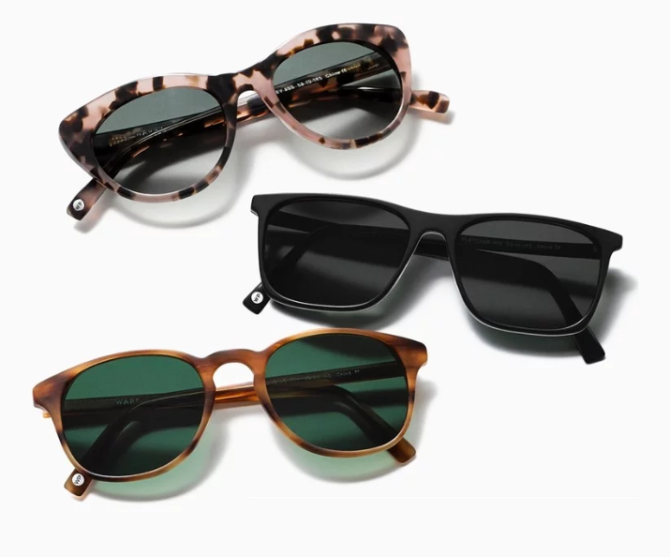
Question 3:
This query allows us to see the completion rate of each question:
The question with the lowest completion rate is “When was your last eye exam?” and not so far behind “Which sahpes do you like?”
Why do you I think is the reason of the low completion rate for when was your last eye exam? I believe the reason why users are not completing “when was your last eye exam” is because they not remember when they las saw the eye doctor, or like me some users may go years with out seeing one.
The reason for the low completion rate of Which shapes do you like? I think people are unsure of what they may be looking for at the moment they are taking the quiz.
SELECT question,
COUNT(DISTINCT user_id)
FROM survey
GROUP BY 1;
Question | COUNT(DISTINCT user_id) | % of users completing this question
1. What are you looking for? | 500 | 100%
2. What's your fit? | 475 | 95%
3. Which shapes do you like? | 380 | 80%
4. Which colors do you like? | 361 | 95%
5. When was your last eye exam? | 270 | 75%

Slide 8
Question 4:
A/B Testing with Home Try-On Funnel
user_id | style | fit | shape | color
4e8118dc-bb3d-49bf-85fc-cca8d83232ac | Women's Styles | Medium | Rectangular | Tortoise
291f1cca-e507-48be-b063-002b14906468 | Women's Styles | Narrow | Round | Black
75122300-0736-4087-b6d8-c0c5373a1a04 | Women's Styles | Wide | Rectangular | Two-Tone
75bc6ebd-40cd-4e1d-a301-27ddd93b12e2 | Women's Styles | Narrow | Square | Two-Tone
ce965c4d-7a2b-4db6-9847-601747fa7812 | Women's Styles | Wide | Rectangular | Black
user_id | number_of_pairs | address
d8addd87-3217-4429-9a01-d56d68111da7 | 5 pairs | 145 New York 9a
f52b07c8-abe4-4f4a-9d39-ba9fc9a184cc | 5 pairs | 383 Madison Ave
8ba0d2d5-1a31-403e-9fa5-79540f8477f9 | 5 pairs | 287 Pell St
4e71850e-8bbf-4e6b-accc-49a7bb46c586 | 3 pairs | 347 Madison Square N
3bc8f97f-2336-4dab-bd86-e391609dab97 | 5 pairs | 182 Cornelia St
user_id | product_id | style | model_name | color | price
00a9dd17-36c8-430c-9d76-df49d4197dcf | 8 | Women's Styles | Lucy | Jet Black | 150
00e15fe0-c86f-4818-9c63-3422211baa97 | 7 | Women's Styles | Lucy | Elderflower Crystal | 150
017506f7-aba1-4b9d-8b7b-f4426e71b8ca | 4 | Men's Styles | Dawes | Jet Black | 150
0176bfb3-9c51-4b1c-b593-87edab3c54cb | 10 | Women's Styles | Eugene Narrow | Rosewood Tortoise | 95
01fdf106-f73c-4d3f-a036-2f3e2ab1ce06 | 8 | Women's Styles | Lucy | Jet Black | 150
SELECT *
FROM quiz
LIMIT 5;
SELECT *
FROM home_try_on
LIMIT 5;
SELECT *
FROM purchase
LIMIT 5;

Slide 9
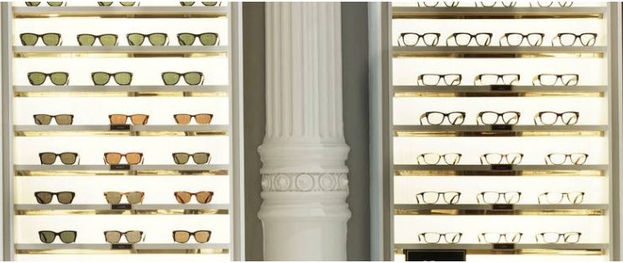
Home Try-On Funnel
The Quiz table contains the following columns:
User_id
Style
Fit
Shape
Color
The home try-on table contains the following columns:
User_id
Number_of_pairs
Address
The purchase table contains the following columns:
User_id
Product_id
Style
Model_name
Color
Price

Slide 10
Question 5:
Created a new table with the layout shown at the bottom:
- Used a LEFT JOIN to combine the three tables, Starting with the top of the funnel (browse) and ending with the bottom of the funnel (purchase)
SELECT DISTINCT q.user_id,
h.user_id IS NOT NULL AS 'is_home_try_on',
h.number_of_pairs,
P.user_id IS NOT NULL AS 'is_purchase'
FROM quiz AS 'q'
LEFT JOIN home_try_on AS 'h'
ON q.user_id = h.user_id
LEFT JOIN purchase AS 'p'
On p.user_id = q.user_id
LIMIT 10;
user_id | is_home_try_on | number_of_pairs | is_purchase
4e8118dc-bb3d-49bf-85fc-cca8d83232ac | 1 | 3 pairs | 0
291f1cca-e507-48be-b063-002b14906468 | 1 | 3 pairs | 1
75122300-0736-4087-b6d8-c0c5373a1a04 | 0 |  | 0
75bc6ebd-40cd-4e1d-a301-27ddd93b12e2 | 1 | 5 pairs | 0
ce965c4d-7a2b-4db6-9847-601747fa7812 | 1 | 3 pairs | 1
28867d12-27a6-4e6a-a5fb-8bb5440117ae | 1 | 5 pairs | 1
5a7a7e13-fbcf-46e4-9093-79799649d6c5 | 0 |  | 0
0143cb8b-bb81-4916-9750-ce956c9f9bd9 | 0 |  | 0
a4ccc1b3-cbb6-449c-b7a5-03af42c97433 | 1 | 5 pairs | 0
b1dded76-cd60-4222-82cb-f6d464104298 | 1 | 3 pairs | 0

Slide 11
Question 6:
Home Try-On Funnel Analysis
Calculating aggregates and comparisons from the LEFT JOIN of quiz, home_try_on and purchase tables
WITH funnels AS (SELECT DISTINCT q.user_id,
h.user_id IS NOT NULL AS 'is_home_try_on',
h.number_of_pairs,
p.user_id IS NOT NULL AS 'is_purchase'
FROM quiz q
LEFT JOIN home_try_on h
ON q.user_id = h.user_id
LEFT JOIN purchase p
ON p.user_id=q.user_id)
SELECT number_of_pairs, COUNT(*) AS 'num_quiz',
SUM(is_home_try_on) AS 'num_home_try_on',
SUM(is_purchase) AS 'num_purchase',
ROUND (100.0 * SUM(is_home_try_on) / (COUNT (user_id)),2) AS 'quiz_to_home_try_on',
ROUND(100.0 * SUM(is_purchase) / SUM(is_home_try_on),2) AS 'home_try_on_to_purchase'
FROM funnels
GROUP BY number_of_pairs
ORDER BY number_of_pairs;
The following table has been produced to calculate the total of people who took the Style quiz , then out of those, the number of people who try the Home Try-on
This table also shows you the options of 3 or 5 pairs and out of those the number of users who finally made a purchase.
It looks like people that received 5 pairs had a higher percentage of going from home try-on to purchase
number_of_pairs | num_quiz | num_home_try_on | num_purchase | quiz_to_home_try_on | home_try_on_to_purchase
 | 250 | 0 | 0 | 0.0
3 pairs | 379 | 379 | 201 | 100.0 | 53.03
5 pairs | 371 | 371 | 294 | 100.0 | 79.25

Slide 12
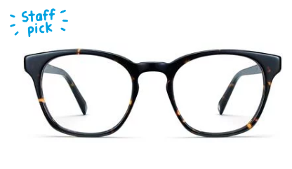
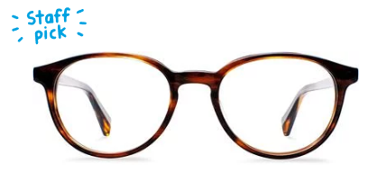
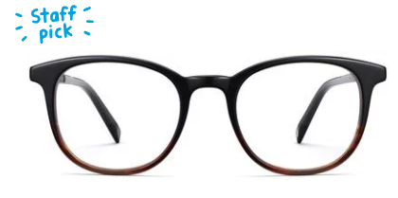
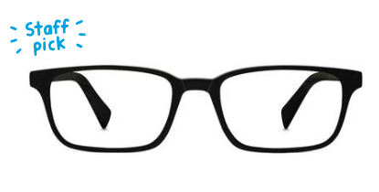
Insights for Warby Parker
SELECT COUNT (style)
FROM quiz
WHERE style LIKE 'Women%';
SELECT COUNT (style)
FROM quiz
WHERE style LIKE 'Men%';
SELECT COUNT (style)
FROM quiz
WHERE style LIKE 'I%';
From the quiz table: It looks like your more popular styles with 469 counts are Women’s style. I would try to focus on capturing women. Often times it’s the women that is purchasing for a men but would browse for themselves first.
SELECT COUNT(fit) FROM quiz
WHERE fit LIKE 'N%'; --Narrow
SELECT COUNT(fit) FROM quiz
WHERE fit LIKE 'M%'; -- Medium
SELECT COUNT(fit) FROM quiz
WHERE fit LIKE 'W%'; --Wide
SELECT COUNT(fit) FROM quiz
WHERE fit LIKE 'I%'; --I'm not sure
As far as the fit, it looks like not many people are skipping this questions, and users seem to like the narrow glasses. I think if your company is able to design somewhere where they can upload a picture of their face, and try on the glasses, you will have more success from quiz- home try-on – purchase.

Slide 13
Insights for Warby Parker
SELECT COUNT (style)
FROM purchase
WHERE style LIKE 'Women%';
SELECT COUNT (style)
FROM purchase
WHERE style LIKE 'Men%';
SELECT COUNT (model_name)
FROM purchase
WHERE model_name LIKE '%Lucy%';
SELECT COUNT (model_name)
FROM purchase
WHERE model_name LIKE '%Dawes%';
SELECT COUNT (model_name)
FROM purchase
WHERE model_name LIKE '%Eugene Narrow%';
SELECT COUNT (model_name)
FROM purchase
WHERE model_name LIKE '%Brady%';
SELECT COUNT (model_name)
FROM purchase
WHERE model_name LIKE '%Monocle%';
SELECT COUNT (model_name)
FROM purchase
WHERE model_name LIKE '%Olive%';
SELECT COUNT (price)
FROM purchase
WHERE price = 150;
SELECT COUNT (price)
FROM purchase
WHERE price = 95;
SELECT COUNT (price)
FROM purchase
WHERE price = 50;
Count Style Womens | Count Style Mens
252 | 243
Purchases by Price
Price | 150 | 95 | 50
Count | 193 | 261 | 41
Model Name Purchased
Lucy | Dawes | Eugene Narrow | Brady | Monocle | Olive
86 | 107 | 116 | 95 | 41 | 50
Over all it looks like women are doing most of the purchasing, but men are not far behind. I think your Staff picks may help people decide which glasses to try out. It also looks like your most expensive glasses are the ones being purchased the most. Take a look at the quality of the $50.00 and see if comparers to the $150.00 once.

Slide 14

Over all I think you guys have the right idea in providing a hazzle free and affordable glasses for people. Your company is doing great in giving back a pair of glasses to people in need. I think that alone will bring in more customers knowing that they are getting a well made product, but as well they are helping.
Thank you

